Slide 1

Phosphorus variation in the Colorado River Watershed
Naila Costa, Dietrich Epp Schmidt, Erin Larson, Stephanie Shousha
Data-driven ecological synthesis summer school
Station de Biologie des Laurentides, Université de Montréal May 7, 2017

Slide 2

DDESSS Project
Phosphorus in the Colorado River Watershed
How does TP, TDP vary with stream size?
How does TP, TDP vary with differing land use?
Predictions
Increased homogeneity in P variability with increasing stream size
Increasing P quantity with increased anthropogenic effect

Slide 3
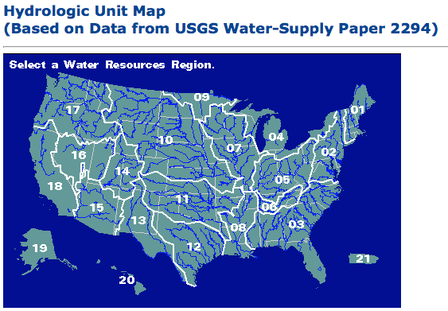
Colorado River Watershed
United States watersheds divided by HUC categories
Up to 8 numbers per division
Colorado River Watershed: HUC2 = 15
HUC4 = 1501 HUC8 = 14050006 (Corral Gulch Near Rangely, CO) Drainage area: 31.8 sqm

Slide 4
Data Management
OpenRefine
Cleaned the two data sets (Phosphorus & Land Use Tables)
R via Jupyter
Average of LandUse by HUC8
SQL
Joined Phosphorus Table to Land Use Table by HUC8 unique identifier
GitHub
R via Jupyter
Standard deviation
Multiple linear regression
Time series

Slide 5
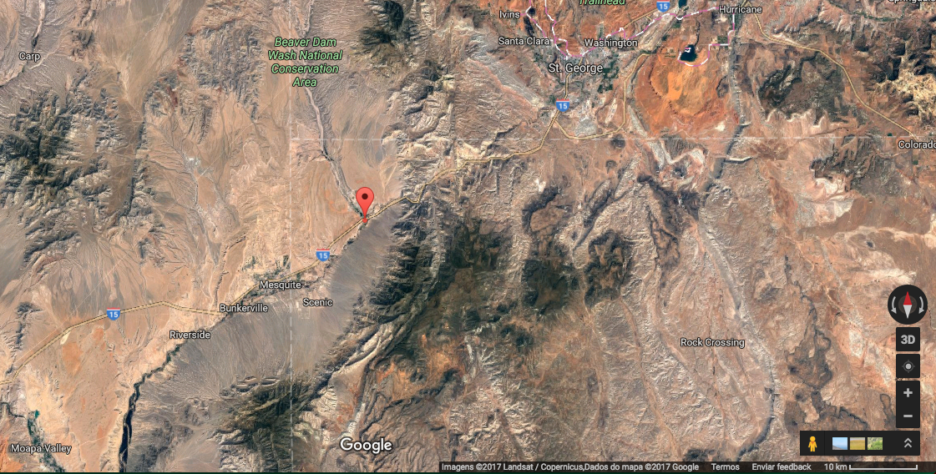
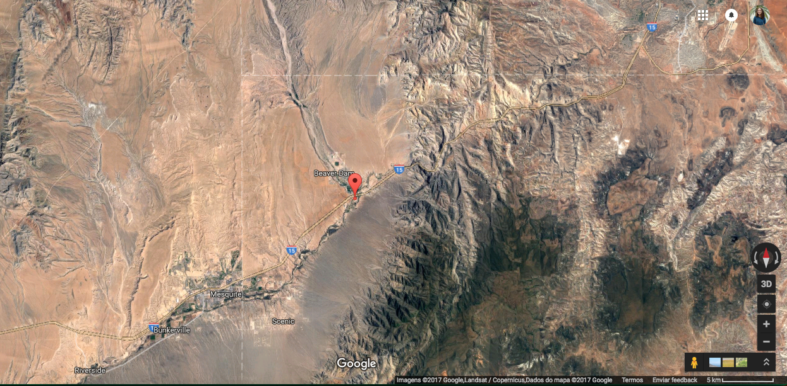
Outliers
10 out of 5053 observations (3 sites)
4.68 to 24 mg/L
Not biologically possible
Unless town, treatment plant, etc
Google map; satellite

Slide 6
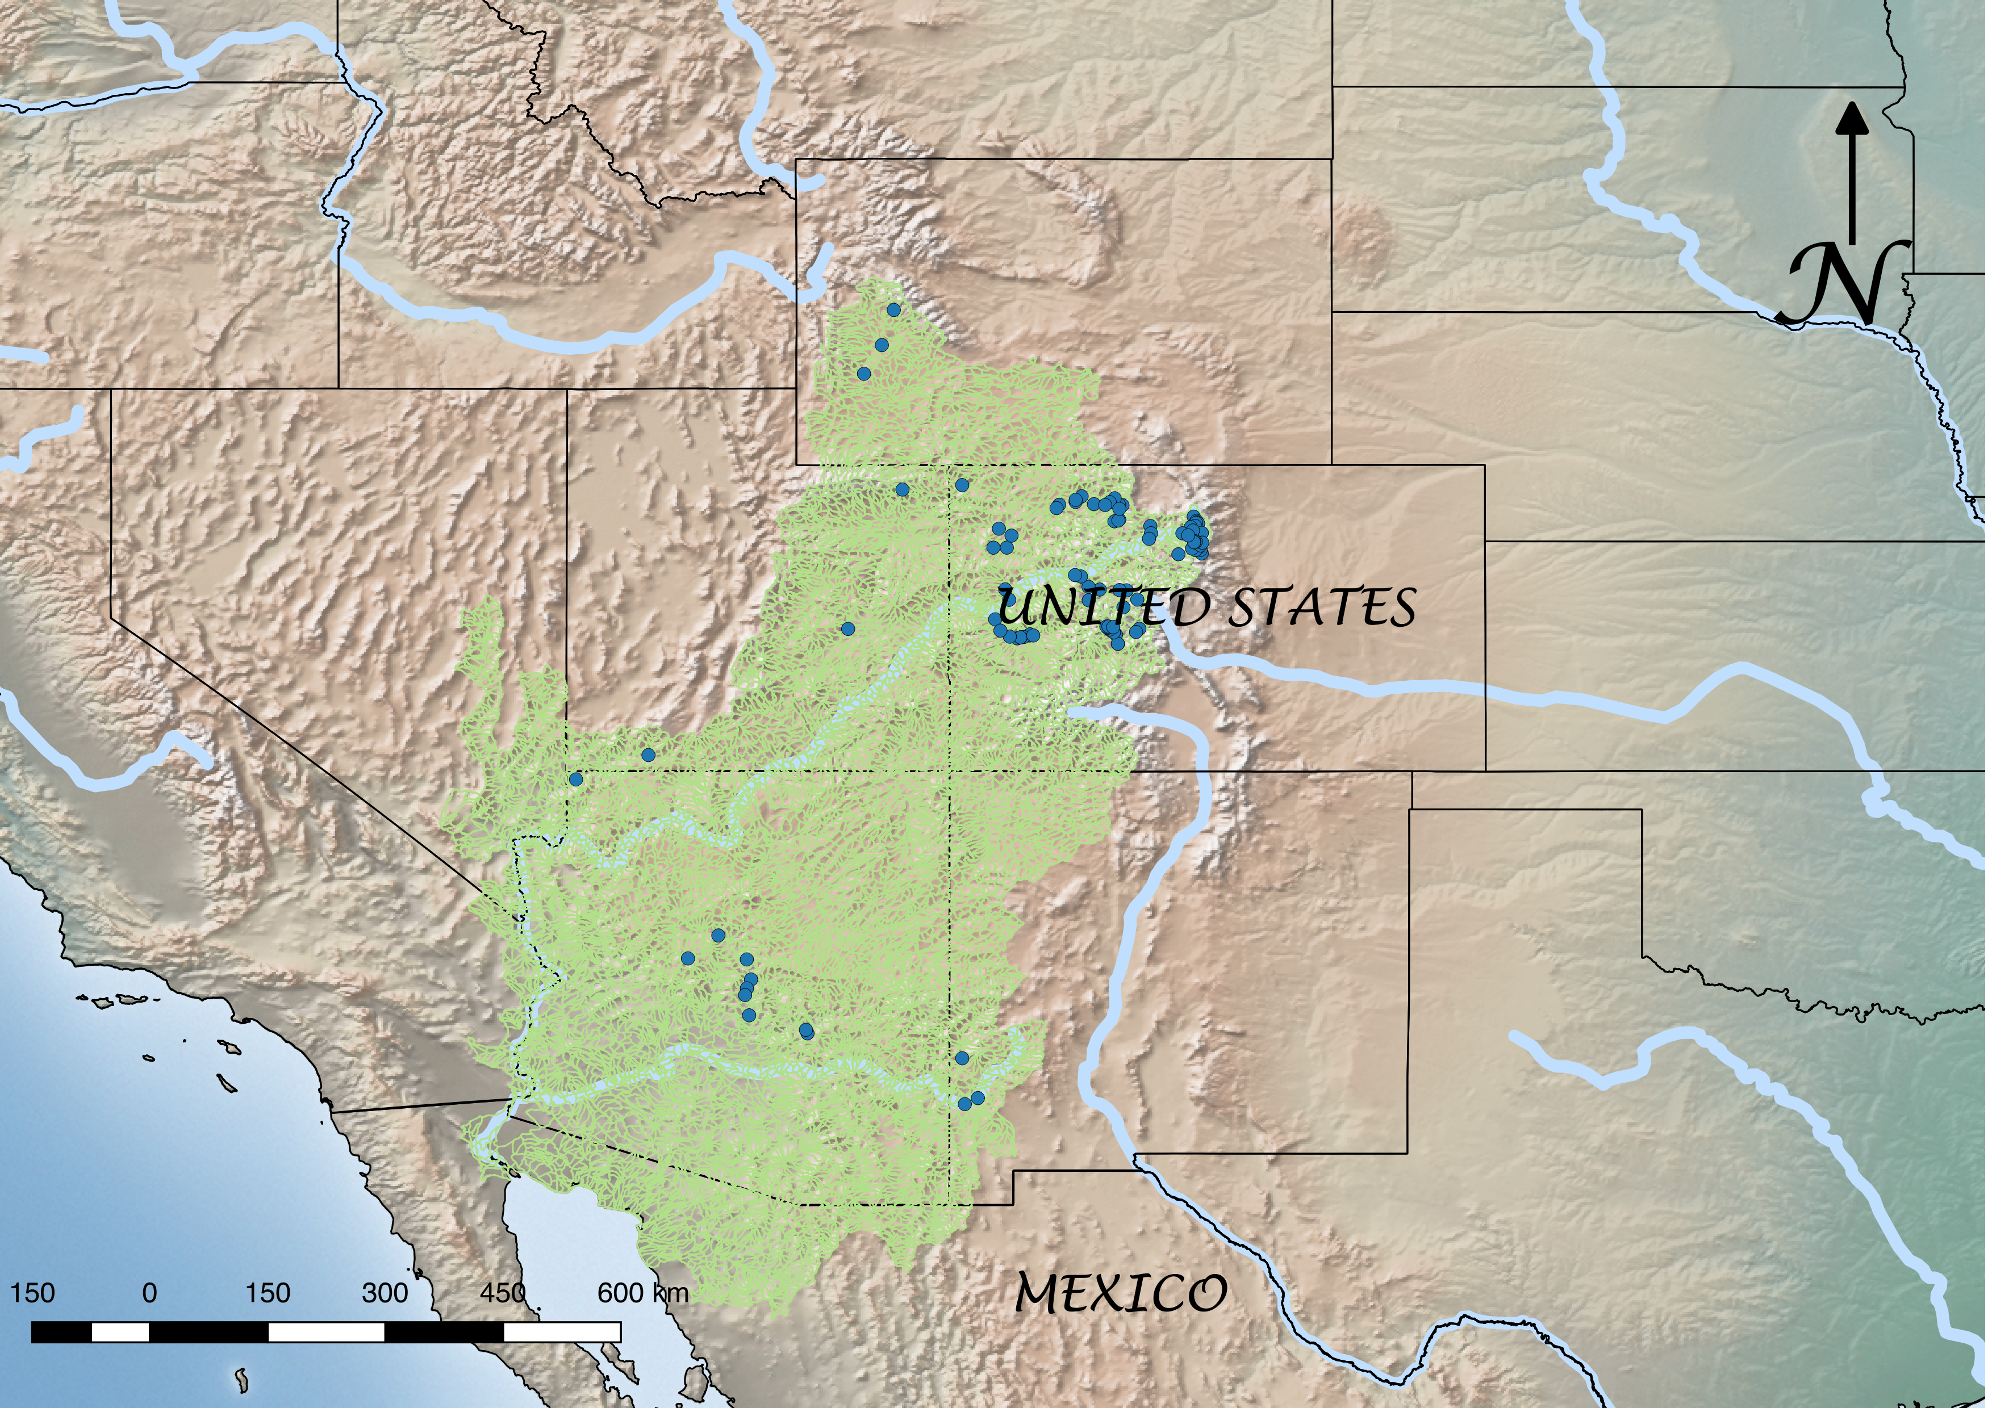

Slide 7
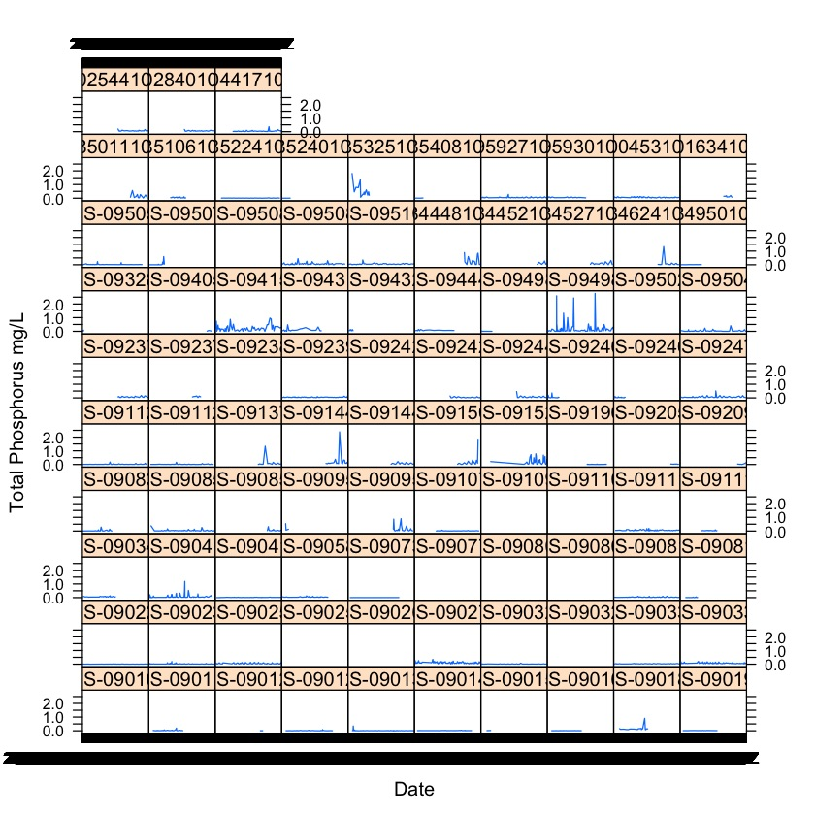
Notes:
Time series: wanted to see if the P varied through time. It doesn’t (do we have a stats to support this point?). So we can infer that if we find a variation depending on streams, then it’s really either the streams or the land use having an effect, and not the season.

Slide 8
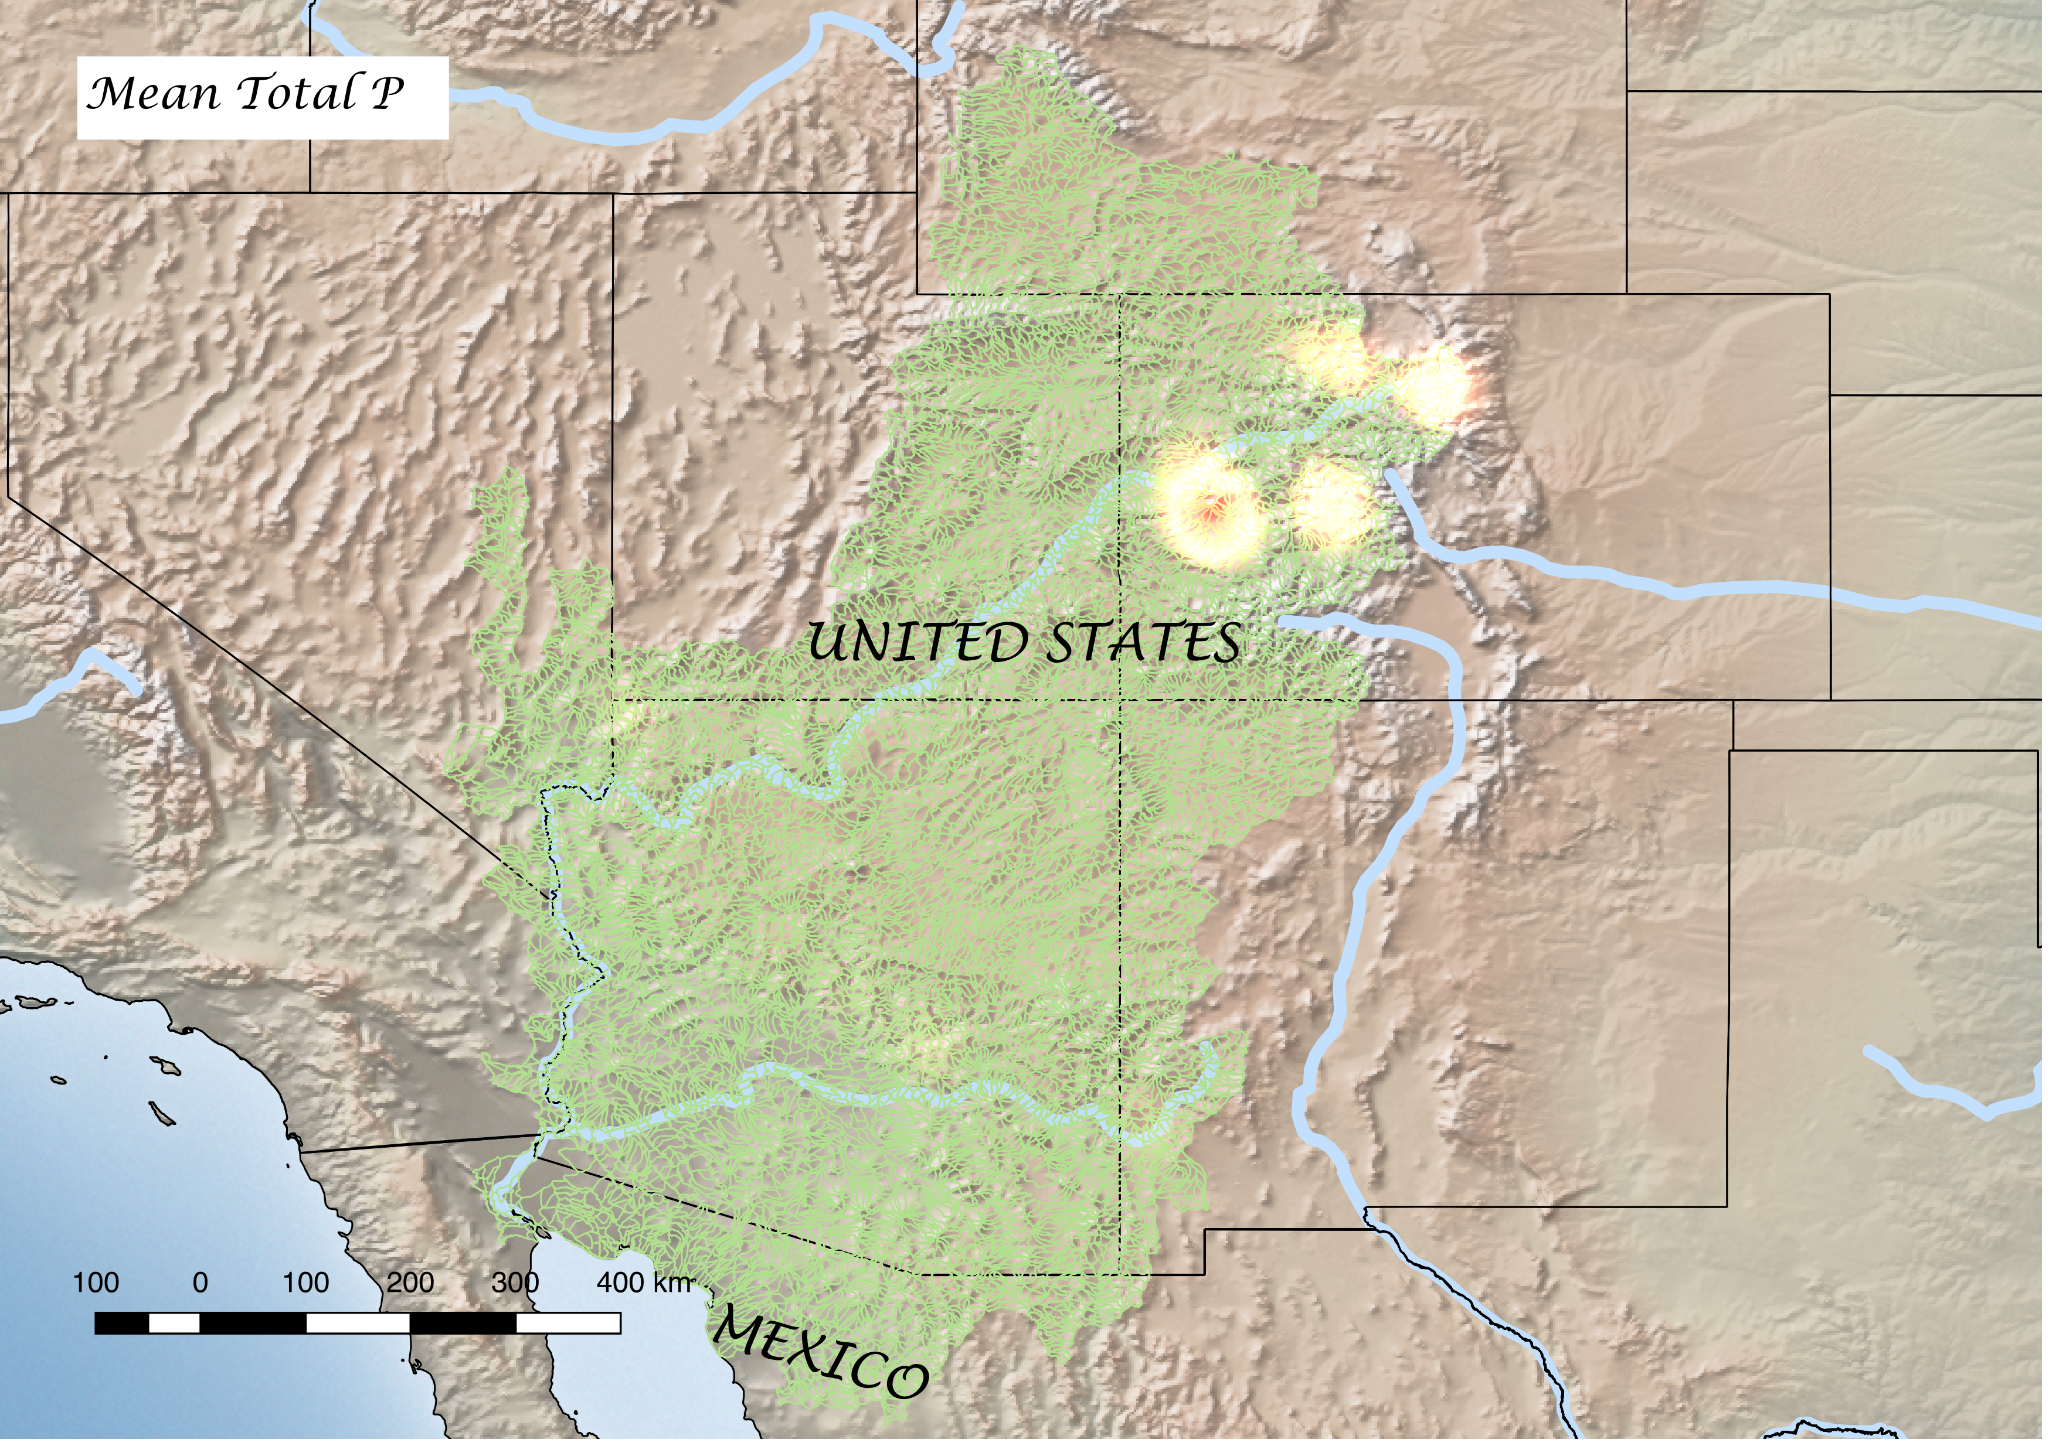
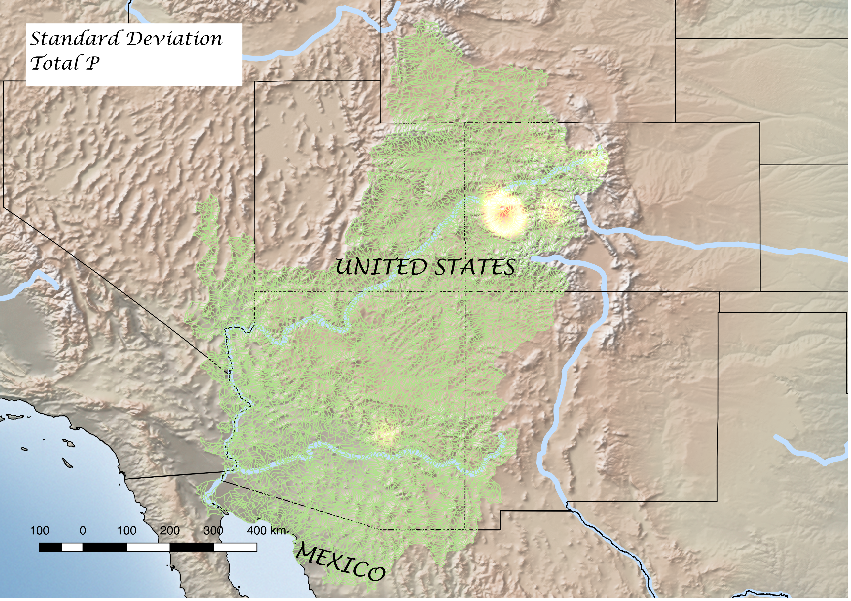
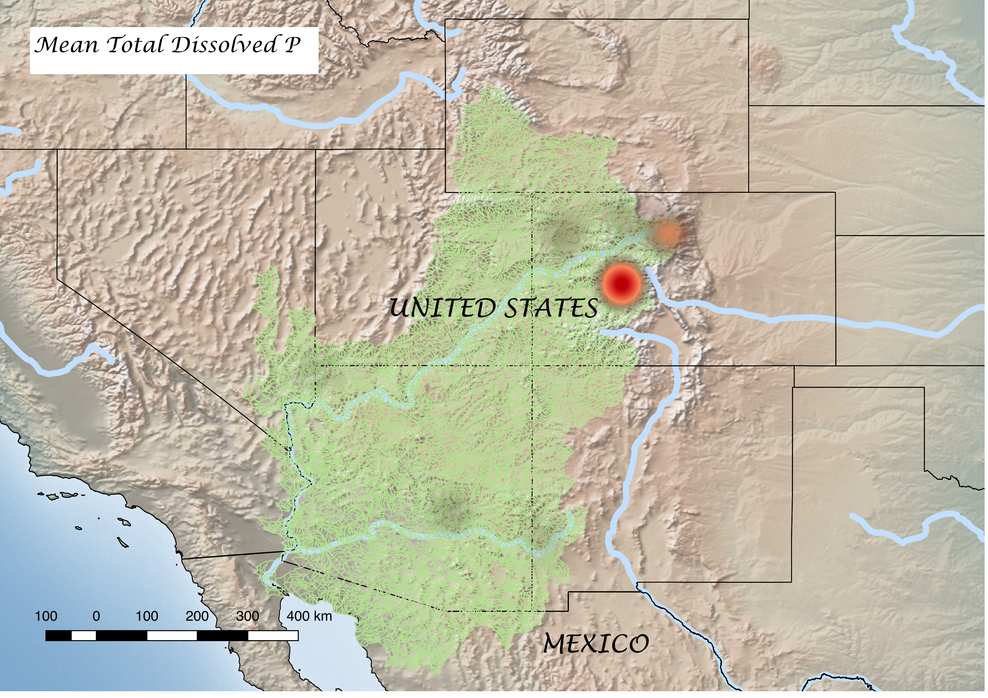
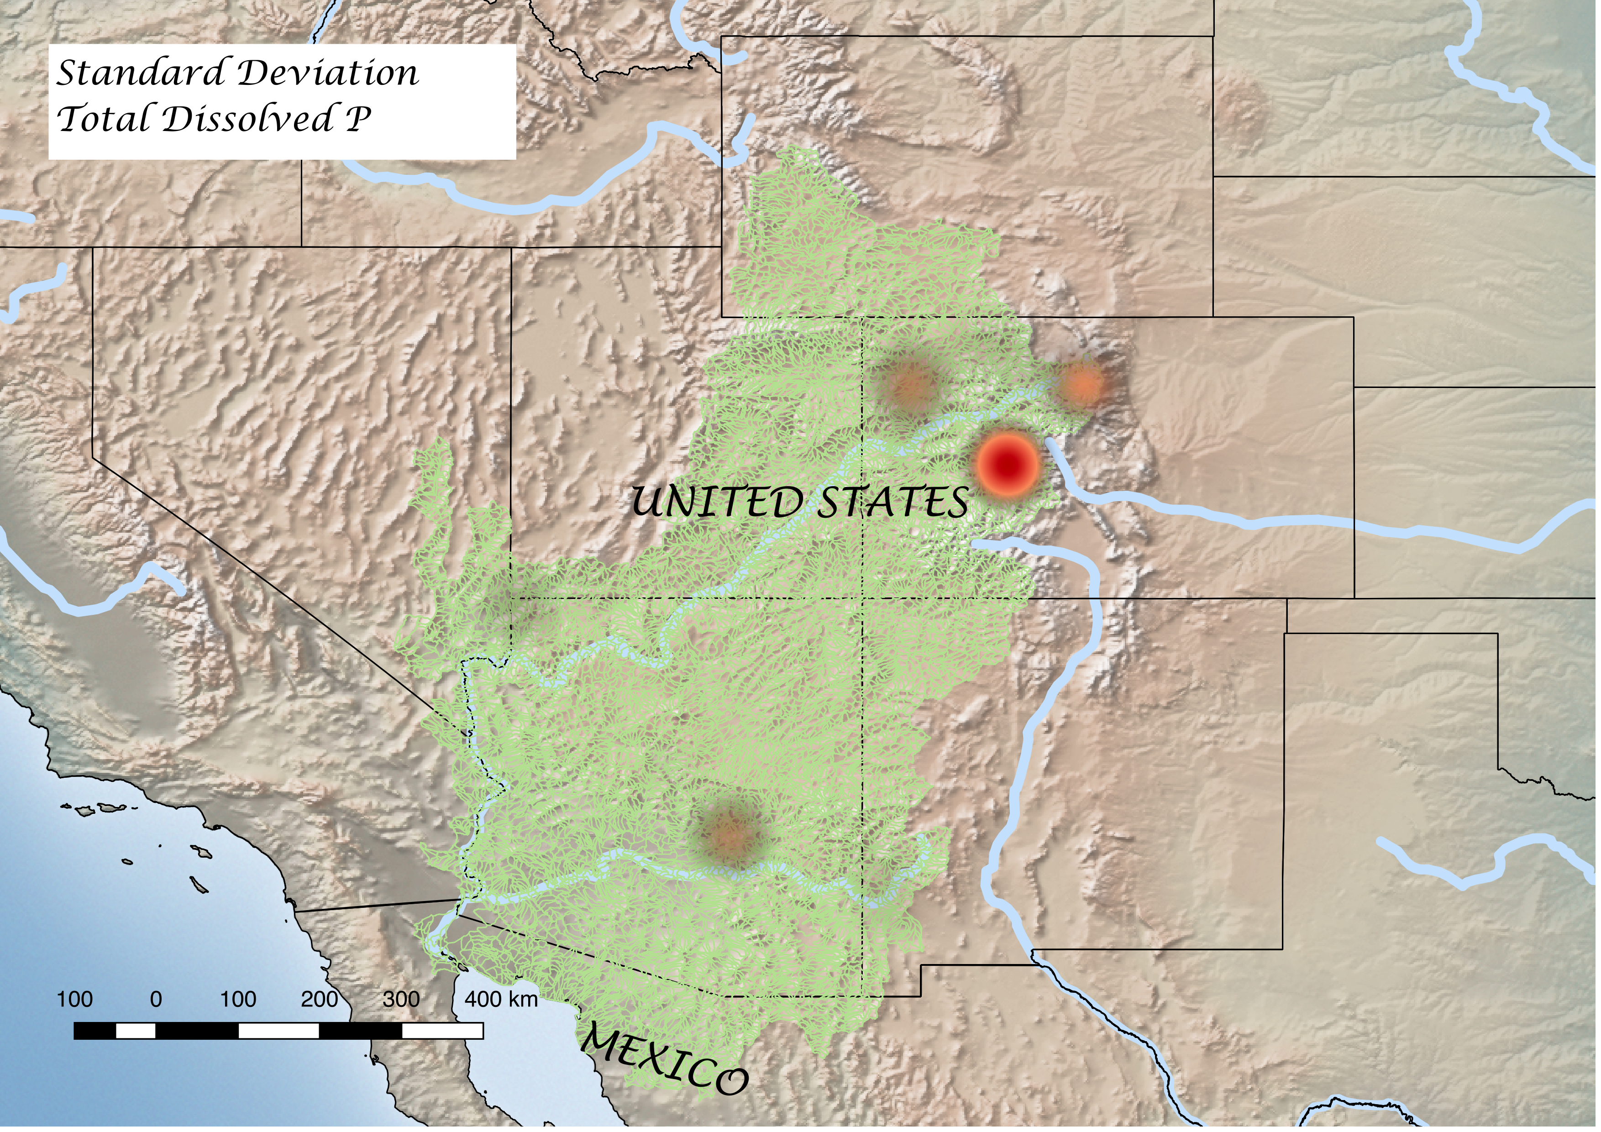
Notes:
Hot spot of P, makes sense bc near Rockies
Created using heat-map plugin in Qgis which both takes into account the density of points and the values of variables associated with those points.
Not a heat map for the whole watershed, just for a concentrated amount of points.
Hotter colours = hotter values

Slide 10
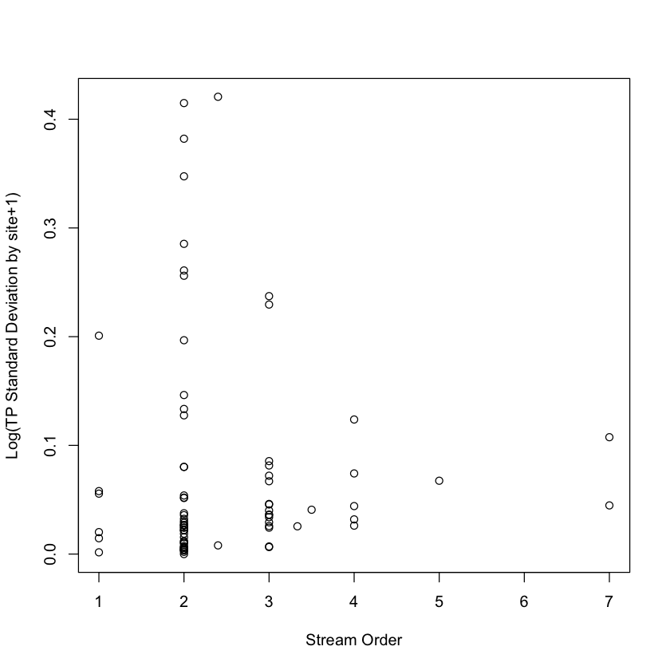
TP variability (log SD by site) vs Stream Order
Notes:
Regression, no significant relationship.
Interesting funneling.
STD by site.

Slide 11
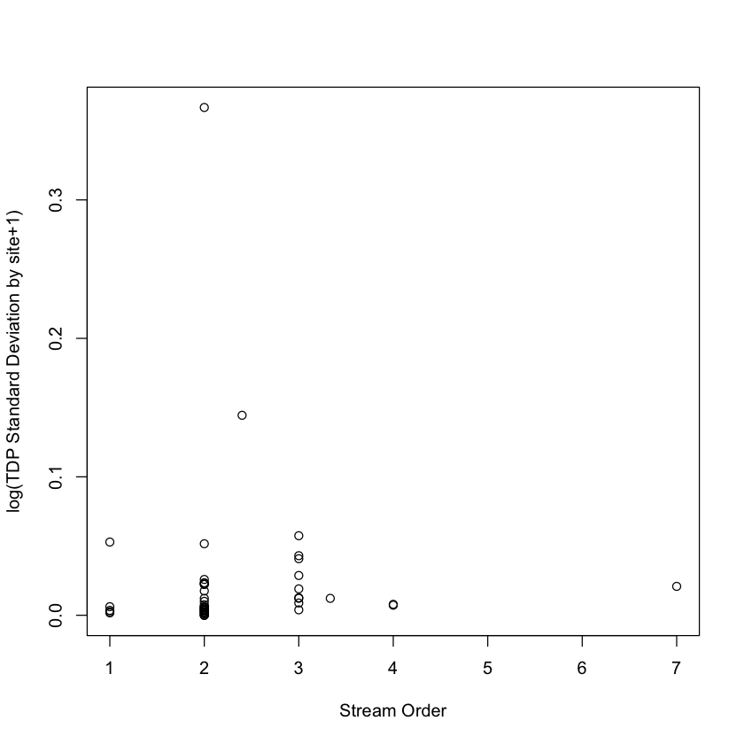
TDP variability (log SD by site) vs Stream Order

Slide 12
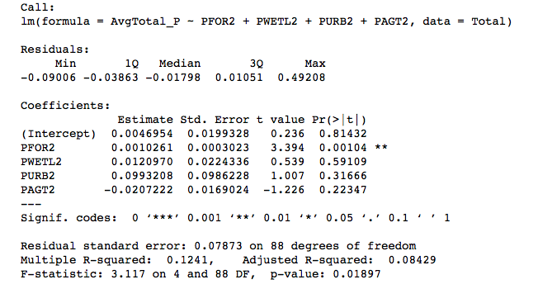
Total P, multiple linear regression

Slide 13
Notes:
Multiple linear regression to see how well the different land use types explained TP. This time with

Slide 15
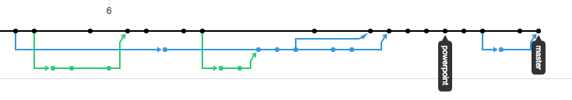
GitHub

Slide 16
Conclusion

Slide 17
Limitations

